Slide 1
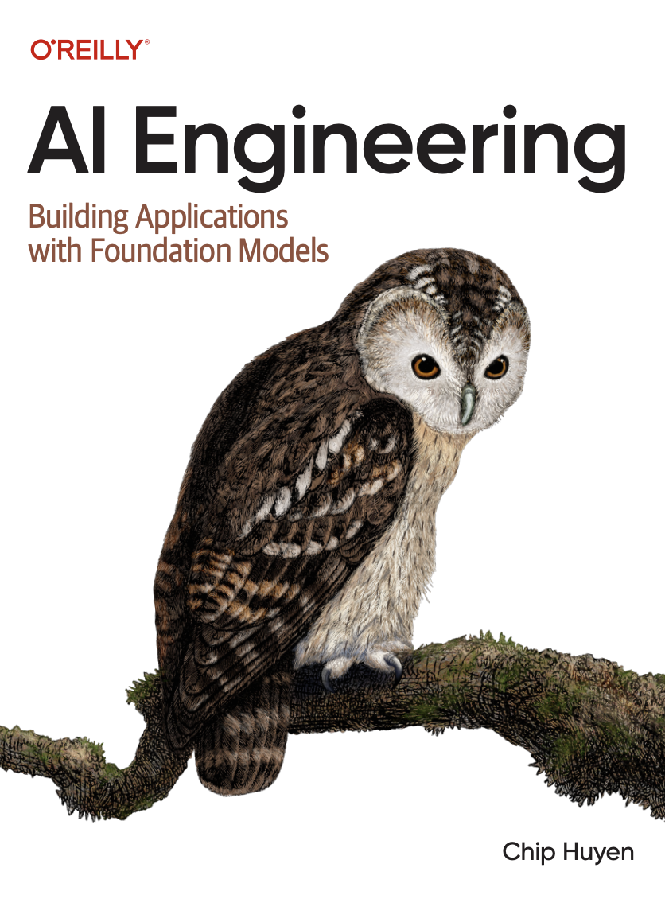

A Comprehensive Summary
Chapter 1, Part 2
Introduction to Building AI Applications with Foundation Models

Slide 2
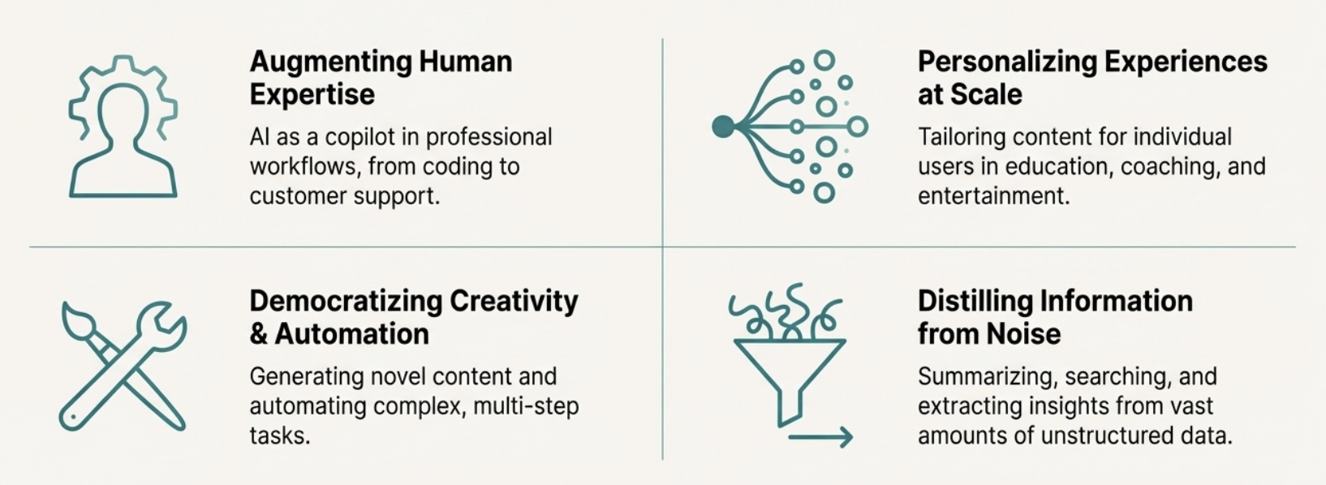
A universe of new applications come to the forefront.

Slide 3
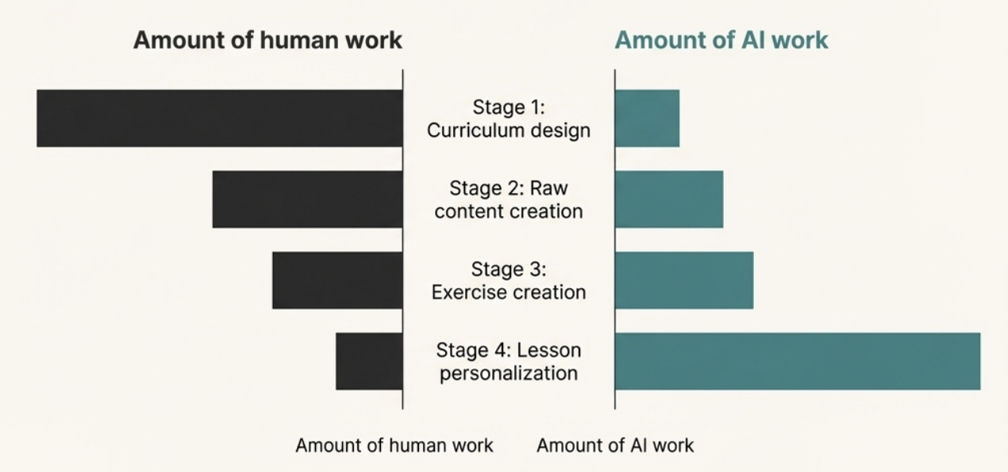
Al's greatest strength is personalizing experiences at scale.
Key Example: Duolingo Course Creation
Al can assist across all four stages of creating a course. However, its value is overwhelmingly concentrated in the final stage: a task that is prohibitively labour-intensive
for humans to perform for every student.

Slide 4
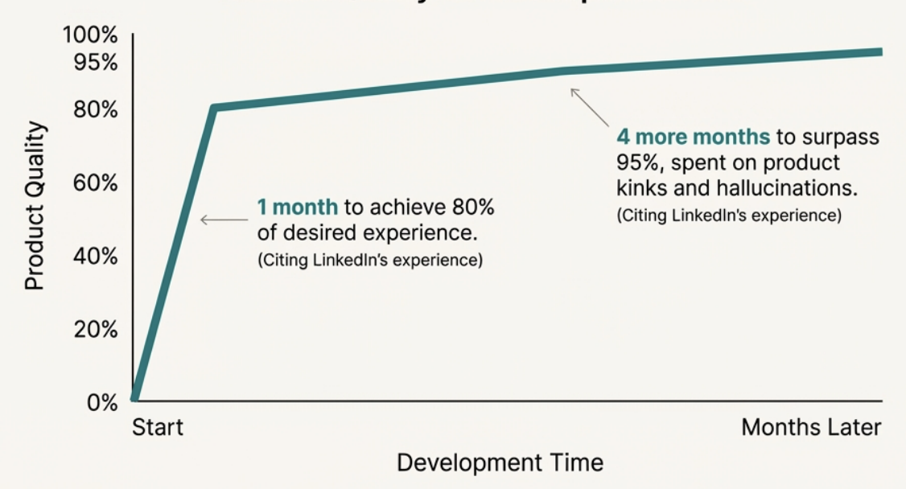
The path from a simple demo to a production-ready product is not linear.
Product Quality vs Development Time
“the journey from 0 to 60 is easy, whereas progressing from 60 to 100 becomes exceedingly challenging.”
Ding et al. (2023)

Slide 5
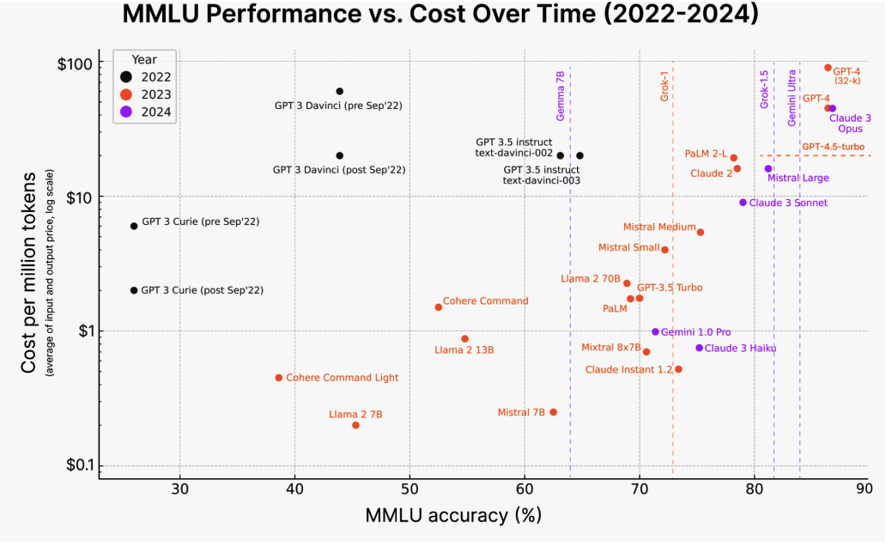
The best model is a moving target.
Insight: Model performance is rapidly increasing while the cost per token is plummeting. The landscape is also shaped by shifting APIs and national regulations.
Takeaway: Your application architecture architecture must be flexible and model-agnostic to survive and adapt. Do not hardcode dependencies to a single model provider.

Slide 6
AI Stack deals with Interface, Models and Infrastructure.
Application Development
Model Development
Infrastructure
Application development involves providing a model with good prompts and necessary context. This layer requires rigorous evaluation.
This layer provides tooling for developing models, including frameworks for modelling, training, finetuning, and inference optimization.
This layer includes tooling for model serving, managing data and compute, and monitoring.
Core responsibilities:
AI Interface, Prompt Engineering, Context Construction and Evaluation
Core responsibilities:
Interface Optimisation, Dataset Engineering, Modelling/Training and Evaluation
Core responsibilities:
Compute Management, Data Management, Serving and Monitoring

Slide 7
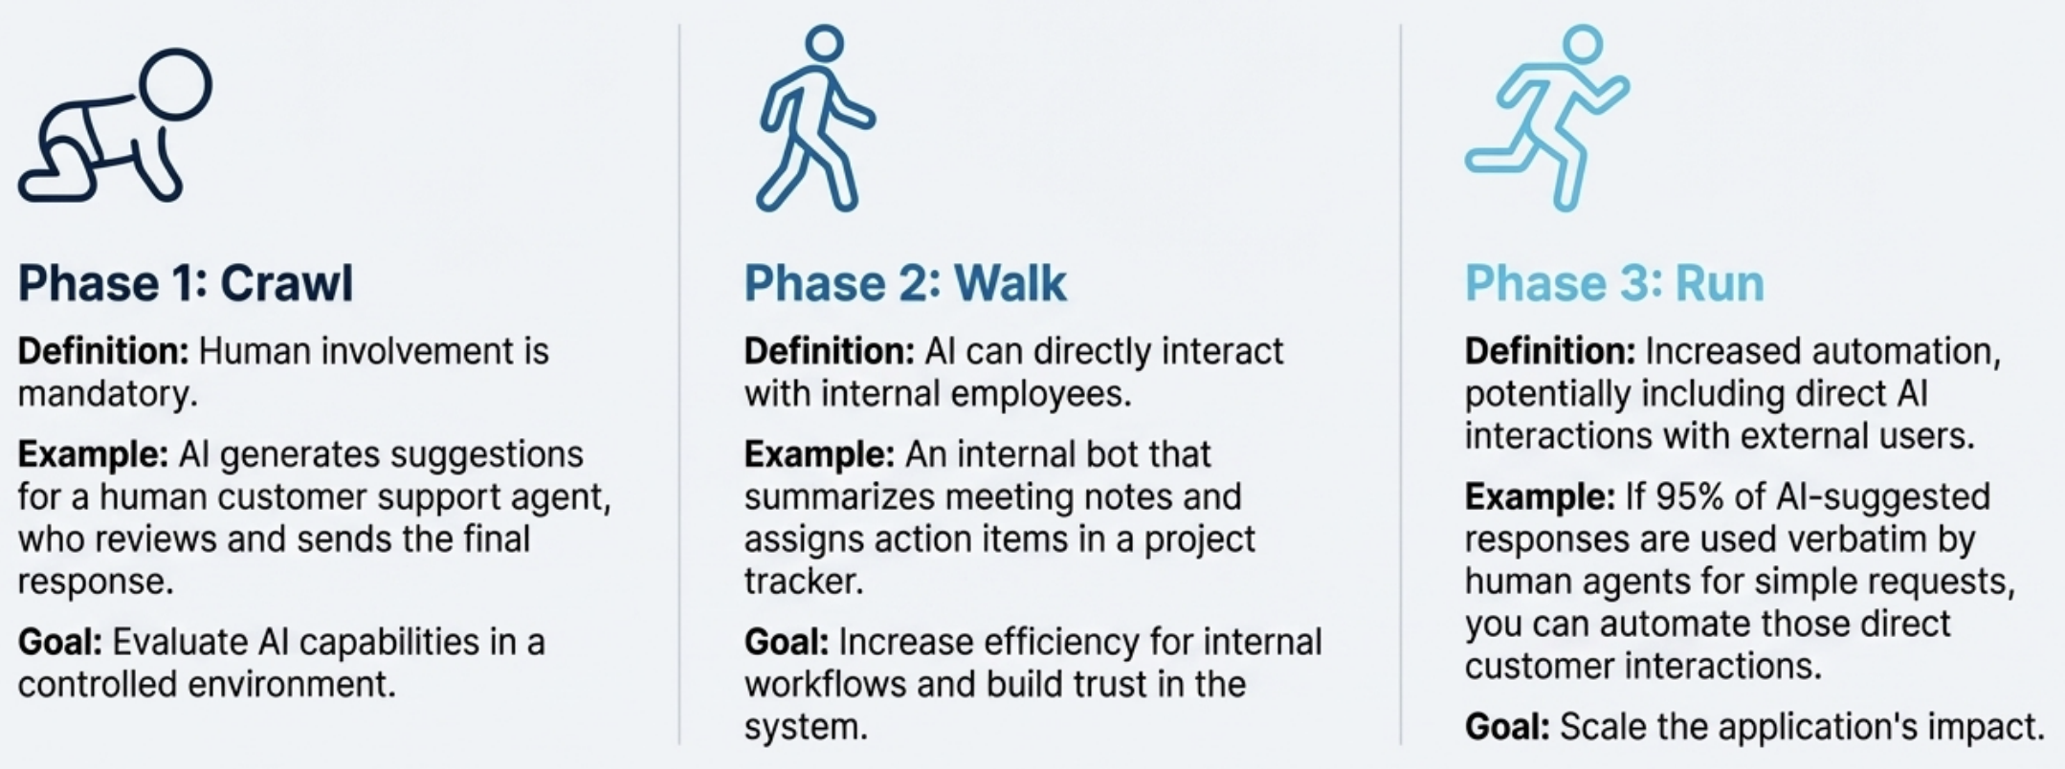
A Phased Approach to Automation: Crawl, Walk, Run
Microsoft proposed a framework for gradually increasing Al automation in products, balancing capability with safety and control. This provides a structured path for deploying Al applications.

Slide 8
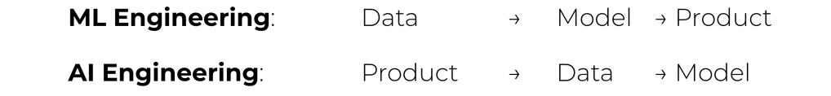
Full Stack vs ML Engineers vs AI Engineers
With the availability of foundation models, ML knowledge is no longer a must-have for building Al applications.
However, ML knowledge is still extremely valuable, as it expands the set of tools that you can use and helps troubleshooting when a model doesn't work as expected.
The new AI engineering workflow rewards those who can iterate fast. With AI models readily available today, it’s possible to start with building the product first, and only invest in data and models once the product shows promise

Slide 9
In the next part, we will discuss
Multilingual Challenges in Training Data
The Limitations of Seq2Seq
The Attention Mechanism
Inside the Transformer Block
The Rise of Sparsity
and much more…

